Slide 1


Logic circuit
Subject: “Logic circuit”
Lecture 1: Introduction
Ganesh Adhikari
ganeshadhikarireal@gmail.com
ganeshpa@nec.edu.np

Slide 2
Logic circuit
Introduction
Books:
A text book of “Logic Circuit and Modern Digital Techniques”.
by Ganesh Adhikari.
“Digital Logic and Computer Design”.
by M.Mano.
3. “Computer System Architecture”.
by M.Mano.

Slide 3
Logic circuit
Course Contents:
Introduction.
Number system and codes.
Boolean Algebra and Logic Gates.
Simplification of Boolean Function.
Combinational logic.
MSI and LSI components in combinational logic design.
Sequential logic.
Register, Counter and Memory unit.
Arithmetic Logic Units.

Slide 4
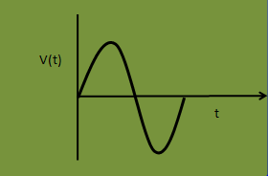
Logic circuit
Analog representations
Quantity vary over a continuous range of values and any value within limited range implies meaning.
Analog = Continuous
eg.
Automobile Speedometer.
Audio-microphone.
Deflection type Multimeter.
Sine wave of Oscilloscope etc.

Slide 5


Digital representations
Digital representations
Quantity changes in discrete steps and deals with only two values, logic high or logic low.
Any value within limited range does not implies any meaning.
Digital = Discrete (Step by Step)
eg.
Digital Watch.
Numerical readout Calculator.
Numerical readout Multimeter.
Sand grains on Beach etc.
1
V(t)
0
t

Slide 6


Digital Techniques Advantages
Important advantages are:
Easier to design.
Easier for information storage.
Operation can be programmed.
Easier to fabricate on IC Chips.
Posses higher Accuracy and greater precision.
Less effected by noise.

Slide 7

Binary Numbers and Codes
Binary to Decimal Conversion:
(10101)₂ = 1x2⁴+0x2³+1x2²+0x2¹+1x2⁰
=16+0+4+0+1
= 21.
= (21)₁₀
(1010.01)₂ = 1x2³+0x2²+1x2¹+0x2⁰+0x2⁻¹+1x2⁻²
= 8+0+2+0+0+(1/4)
= (10.25)₁₀

Slide 8

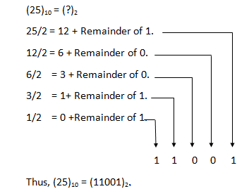
Binary Numbers and Codes
Decimal to Binary Conversion:
Repeated division method.
LSB
MSB

Slide 9
Binary Numbers and Codes
Octal number system
Base of eight mean, it has eight possible digits: 0,1,2,3,4,5,6 & 7.
Octal to Binary conversion:
Octal digit 0 1 2 3 4 5 6 7
Binar.equiv. 000 001 010 011 100 101 110 111
(351)₈ = (?)₂
(351)₈ = 3 5 1
011 101 001
(351)₈ = (011101001)₂
Binary to octal conversion:
It is the reverse of foregoing process.

Slide 10

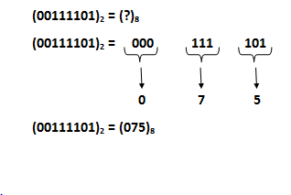
Binary Numbers and Codes
Binary to octal conversion:
Octal to Decimal conversion:
(235)₈ = (?)₁₀
(235)₈ = 2x8²+3x8¹+5x8⁰
= 2x64+3x8+5x1
= 128+24+5
= 157.
Thus, (235)₈ = (157)₁₀

Slide 11
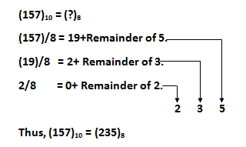
Binary Numbers and Codes
(13.4)₈ = (?)₁₀
(13.4)₈ = 1x8¹+3x8⁰+4x8⁻¹
= 1x8+3x1+(4/8)
= 8+3+(1/2)
= 11.5
Thus, (13.4)₈ = (11.5)₁₀
Decimal to Octal Conversion:

Slide 12
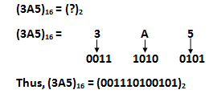
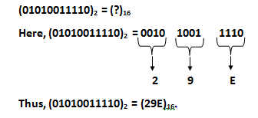
Binary Numbers and Codes
Hexadecimal Number System:
It uses base 16 and has 16 possible digit symbols, the digit 0 through 9 plus letters A, B, C, D, E & F.
The digits A to F are equivalent to decimal values 10 through 15.
Hex to Binary conversion:
Binary to Hex conversion:

Slide 13

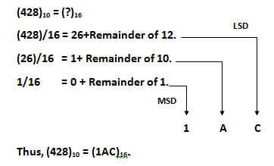
Binary Numbers and Codes
Hex to Decimal Conversion:
(5A3.8)₁₆ = (?)₁₀
(5A3.8)₁₆ = 5X16²+10X16¹+3X16⁰+8X16⁻¹
= 5X256+160+3X1+[8/16]
= 1280+160+3+[1/2]
= 1443.5
Thus, (5A3.8)₁₆ = (1443.5)10.
Decimal to Hex Conversion:

Slide 14
Binary Coded Decimal (BCD)Code
BCD Code:
Each decimal digit, 0 through 9 is represented by its four bits binary equivalent.
eg. A decimal number 3059 to BCD.
3 0 5 9 (Decimal)
0011 0000 0101 1001 (BCD)
BCD to Decimal:
eg. BCD (0111000110001001) to Decimal.
Here, 0111 0001 1000 1001
7 1 8 9
eg. BCD (001110110101) to Decimal.
Here, 0011 1011 0101
3 Forbidden code 5
indicates error in BCD

Slide 15
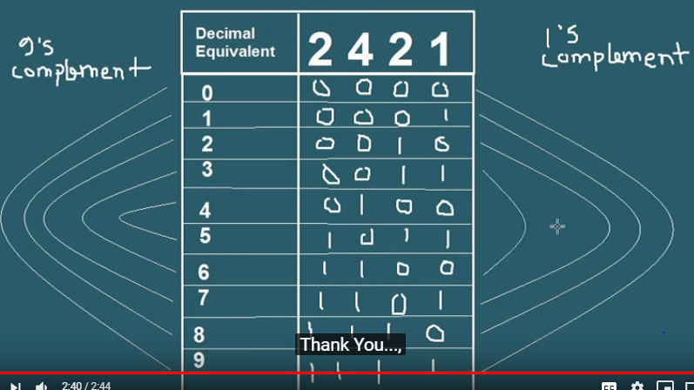
2421 BCD code

Slide 16
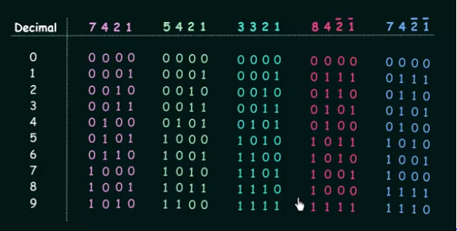
BCD code
0

Slide 17
Error Detection Codes
An error detection code
used to detect errors
during transmission.
The detected error can’t
be corrected but it’s
presence is indicated.
A parity bit is an extra
bit included with message
to make total number
of 1’s either odd or even.
Message | P(Odd) | Message | P(Even)
0000 | 1 | 0000 | 0
0001 | 0 | 0001 | 1
0010 | 0 | 0010 | 1
0011 | 1 | 0011 | 0
0100 | 0 | 0100 | 1
0101 | 1 | 0101 | 0
0110 | 1 | 0110 | 0
0111 | 0 | 0111 | 1
1000 | 0 | 1000 | 1
1001 | 1 | 1001 | 0
1010 | 1 | 1010 | 0
1011 | 0 | 1011 | 1
1100 | 1 | 1100 | 0
1101 | 0 | 1101 | 1
1110 | 0 | 1110 | 1
1111 | 1 | 1111 | 0

Slide 18
Reflected Code(Gray-Code)
Gray Code
It becomes convenient to use
reflected code to represent
the digital data converted
from analog data.
The reflected code changes
by one bit as it proceeds
from one number to the next.
A typical application , Analog
data represented by Continues
change of shaft Position.
Decimal | Binary Code | Gray Code
0 | 0000 | 0000
1 | 0001 | 0001
2 | 0010 | 0011
3 | 0011 | 0010
4 | 0100 | 0110
5 | 0101 | 0111
6 | 0110 | 0101
7 | 0111 | 0100
8 | 1000 | 1100
9 | 1001 | 1101
10 | 1010 | 1111
11 | 1011 | 1110
12 | 1100 | 1010
13 | 1101 | 1011
14 | 1110 | 1001
15 | 1111 | 1000

Slide 19
Alphanumeric Codes
Alphanumeric Codes
Used to represents all of various characters (eg. Letter of alphabet, punctuation marks, and other special characters as well as numbers) and function that found on computer keyboard.
A complete alphanumeric code includes:
26 lowercase letters.
26 uppercase letters.
10 numeric digits.
7 punctuation marks.
20 to 40 other characters such as +, /, %, *, & and so on.

Slide 20
Alphanumeric Codes
ASCII Code
Most widely used alphanumeric code is the “American Standard Code for Information Interchange (ASCII) Code.
It is a seven bit code and so it has 2⁷ = 128 possible code groups.
Used for transfer of alphanumeric information between a computer and external devices such as printer or another computer.
What actual bit strings would a computer transmit to send message “GOOD” using ASCII with even parity?

Slide 21
Digital Arithmetic Operation
Binary Addition
0+0 = 0
0+1 = 1
1+1 = 10 = 0 + carry of 1 into next position.
1+1+1 = 11 = 1+ carry of 1 into next position.
eg. 1100+1101
1100
+1101
-----------------
11001
eg. 101.01
+100.10
------------------
1001.11

Slide 22
Digital Arithmetic Operation
1’s Complement Form:
1’s Complement obtained by changing each 0 to a 1 and each 1 to a 0.
eg. 1 0 1 0 1 0 1 Original binary number.
0 1 0 1 0 1 0 1’s Complement number.
2’s Complement Form:
2’s Complement obtained by adding 1 to least significant bit position to 1’s complement number.
eg. 101101 Original binary number.
010010 1’s Complement.
+ 1 Add 1.
---------------------------
010011 2’s complement of original binary number.

Slide 23

Digital Arithmetic Operation
Signed number representation using 2’S Complement
Rule1
For positive number, the magnitude is represented in its true binary form, and a sign bit 0 attached in front of MSB.
eg. = + (25)₁₀
Sign bit (+) True binary number
Rule 2
For negative number, the magnitude must represent in 2’s complement form and a sign bit 1 must attach in front of MSB.
= - (25)₁₀
Sign bit (-) 2’s Complement
0 | 1 | 1 | 0 | 0 | 1
1 | 0 | 0 | 1 | 1 | 1

Slide 24
Digital Arithmetic Operation
Illustrate signed number as a signed binary number in 2’s complement form.
+ (8) - (8) + (15) - (15) - (12)
Addition in 2’s complement system
i) (+9) + (6) ii) (+9) + (-6) iii) (-9) + (+6) iv) (+9) + (-9)
iii) (-9) + (+6) (-9) 10111
+(9) = 01001 (+6) 00110
10110 1’s complement ------------
+ 1 (Add 1) (-3) 11101
-------------------
-(9)= 10111 (2’s complement of -9)

Slide 25
Digital Arithmetic Operation
iv) (+9) + (-9)
(+9) = 01001
(-9) = 10111
0 = 1(00000)
Disregarded
Binary subtraction
1001
- 0110
0011
A B | BR | D
0 0 | 0 | 0
0 1 | 1 | 1
1 0 | 0 | 1
1 1 | 0 | 0

Slide 26
Digital Arithmetic Operation
Subtraction in 2’s complement
Step1: Negate the subtrahend.
Step2: Add this to the minuend.
eg. Let minuend = 8 and subtrahend = 5.
Binary Multiplication
0x1 = 0 101
1x1 = 1 x 101
eg. 101 x 101 101
000
101
11001

Slide 27
Digital Arithmetic Operation
Binary Division
0 /1 = 0
1/1 = 1 101
101) 11001
101
10
101
101
000

Slide 28
Digital Arithmetic Operation
BCD Addition
Each decimal digit represent it by a four bit code ranging from 0000 to 1001.
Sum (< or =) to 9:
eg. 5 (0101)+4 (0100) 5 0101 BCD for 5.
+4 0100 BCD for 4.
9 1001
ii) Sum [41(0100 0001) + 14(0001 0100)]
41 0100 0001 BCD for 41.
+14 0001 0100 BCD for 14.
55 0101 0101 BCD for 55.

Slide 29
Digital Arithmetic Operation
ii) Sum > 9:
The sum must required to corrected by addition of six (0110), in doing so the sum get converted it into valid BCD sum.
eg. 9 1001
6 0110
15 1111 Invalid BCD sum.
Add six to convert it into valid sum.
1111
+0110
0001 0101 Valid BCD sum.

Slide 30


Digital Arithmetic Operation
BCD addition of (36 + 54)
36 0011 0110
54 0101 0100
90 1000 1010 Invalid sum.
1 0110 Add 6.
1001 0000 Valid BCD sum.

Slide 31
Digital Arithmetic Operation
Hexadecimal Addition
Insert decimal
equivalent for digit >9.
For sum ≤ 15, then
directly represent as
hex digit.
For sum ≥ 16, then
Subtract 16 and carry
a 1 to next digit
position.
Decimal | Hexadec | Decimal | Hexadec | Decimal | Hexadec
0 | 0 | 16 | 10 | 32 | 20
1 | 1 | 17 | 11 | 33 | 21
2 | 2 | 18 | 12 | 34 | 22
3 | 3 | 19 | 13 | 35 | 23
4 | 4 | 20 | 14 | 36 | 24
5 | 5 | 21 | 15 | 37 | 25
6 | 6 | 22 | 16 | 38 | 26
7 | 7 | 23 | 17 | 39 | 27
8 | 8 | 24 | 18 | 40 | 28
9 | 9 | 25 | 19 | 41 | 29
10 | A | 26 | 1A | 42 | 2A
11 | B | 27 | 1B | 43 | 2B
12 | C | 28 | 1C | 44 | 2C
13 | D | 29 | 1D | 45 | 2D
14 | E | 30 | 1E | 46 | 2E
15 | F | 31 | 1F | 47 | 2F

Slide 32
Digital Arithmetic Operation
Hex addition of (58+36) 58
36
8E
Hex addition of (5AE+31E) 5AE
31E
8CC
Hex subtraction
Take 2’s complement of hex subtrahend.
Add it to minuend.
Any carry out of MSD position will be disregarded.

Slide 33
Digital Arithmetic Operation
Subtract 3C2 from 781.
Convert subtrahend (3C2) to its 2’s complement.
3C2
0011 1100 0010 F F F
1100 0011 1110 - 3 C 2
C 3 D
C 3 E + 1
Add it to minuend (781). C 3 E
7 8 1
+ C 3 E
1 3 B F
Disregard carry.

Slide 34

Logic gates and Boolean Algebra
Logic gates constructed by using switches, relays, transistors, diode or Ics.
Logic gates are building blocks for any digital circuit.
AB | Y=AB
00 | 0
01 | 0
10 | 0
11 | 1
A
Y
B
AND gate
The symbol for AND gate and their corresponding truth table is shown above.
Sometimes it is called all or nothing gate.
Output becomes high, if all inputs are at high.
Output becomes low, if any one input is at low.

Slide 35
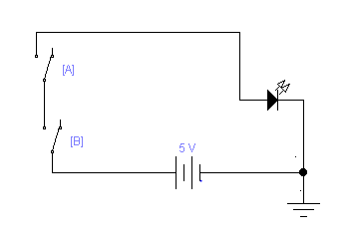
Logic gates and Boolean Algebra

Slide 36

Logic gates and Boolean Algebra
OR Gates:
The logic symbol for OR gate and their corresponding truth table is shown in diagram.
The output becomes high, if at least any one input is at high.
The output becomes low, if all input becomes at low.
AB | Y=A+B
00 | 0
01 | 1
10 | 1
11 | 1
A
Y
B

Slide 37
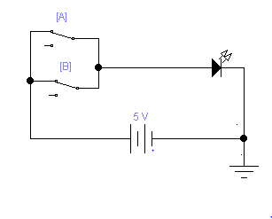
Logic gates and Boolean Algebra
Y

Slide 38
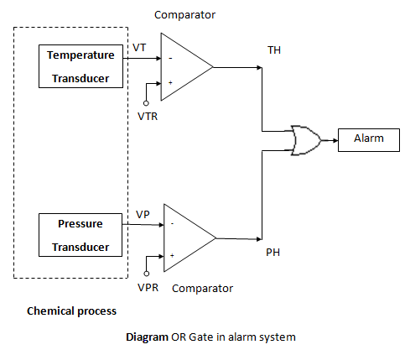
Logic gates and Boolean Algebra

Slide 39
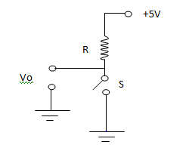
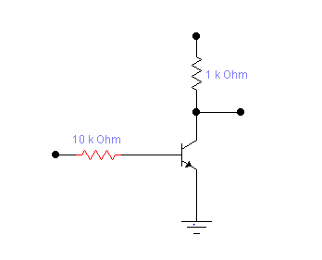
Logic gates and Boolean Algebra
NOT Gate Operation:
The basic symbol and truth table for NOT gate is as shown in diagram.
A NOT Gate i.e. also called inverter has one input and one output.
A | Y
0 | 1
1 | 0
A
Y = A
+5V
RC
Vout
A

Slide 40

Logic gates and Boolean Algebra
NOR Gate:
The NOR gate and it’s corresponding truth table is as shown in diagram.
The small circle at the tip represents inversion operation.
AB | Y
00 | 1
01 | 0
10 | 0
11 | 0
A
Y = (A+B)
B
The NOR Gate equivalent circuit can be realized via several means as shown in diagram.

Slide 41
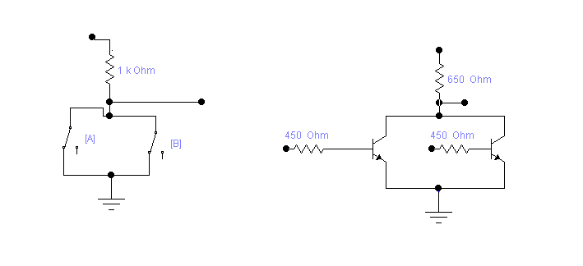
Logic gates and Boolean Algebra
+5V
+5V
R
Rc
Vo
A
B

Slide 42

Logic gates and Boolean Algebra
NAND Gate:
The NAND Gate and it’s corresponding truth table is as shown in diagram.
The small circle at the tip of the gate represents inversion operation.
The NAND gate equivalent circuit can be realized via several means as shown in diagram.
AB | Y
00 | 1
01 | 1
10 | 1
11 | 0
A
y = (AB)
B

Slide 43
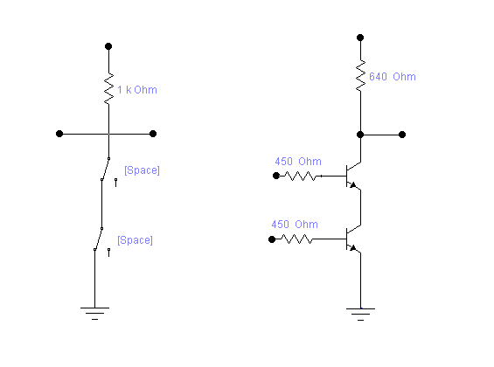
Logic gates and Boolean Algebra
+5V
+5V
RC
Vin
Vo
Vo
S1
A
RB
S2
B
RB

Slide 44

Logic gates and Boolean Algebra
Exclusive-OR gate:
The logic symbol and corresponding truth table for Exclusive OR gate is as shown in diagram.
Sometimes it referred to as “any but not all gate”.
It also represented as ‘XOR’ gate and symbol indicated in output expression.
+
AB | Y
00 | 0
01 | 1
10 | 1
11 | 0
A
Y = A B
= A B + A B
+
B

Slide 45

Logic gates and Boolean Algebra
Exclusive NOR gate:
The logic symbol and corresponding truth table for Exclusive NOR gate is as shown in diagram.
The term exclusive NOR gate be often represented as ‘XNOR’ gate.
The output of ‘XNOR’ gate is the complement of ‘XOR’ truth table, due to circle at tip of ‘XOR’ gate.
AB | Y
00 | 1
01 | 0
10 | 0
11 | 1
A
Y = A . B
= A B + A B
B

Slide 46

Logic gates and Boolean Algebra
NAND and NOR gate as a universal gate:
As AND, OR, NOT gate can be realized using NAND and NOR gate, these gates are called Universal gate.
The entire logic system can be implemented by using any of these two gates.
NOR gate as Universal gate:
A
Y = A + A = A
Y = A

Slide 47

Logic gates and Boolean Algebra
A+B
A+B
A
A
Y = A+B
B
B
A
A
A
Y = A+B
= AB
Y = AB
B
B
B

Slide 48

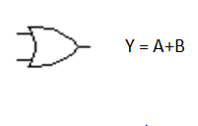
Logic gates and Boolean Algebra
A
Y = A A = A
A
Y= A
A
AB
Y = AB
B
A
A
A
Y = A B
= A+B
B
B
B

Slide 49
Logic gates and Boolean Algebra
Logic gates and Boolean Algebra
DEMORGAN’S THEOREMS:
De Morgan contributed two important theorem for Boolean algebra.
Theorem1:
A+B = A . B
Theorem2:
A . B = A + B
Simplify the following expressions using De Morgan’s Theorem.
ABCD
2. A + B + C + D

Slide 50
Logic gates and Boolean Algebra
Min-term and Max-terms:
In engineering text, sum of
products form is called minterm.
eg. Y= AB+CD+DEFG.
Similarly, product of sum is
called maxterm.
eg. Y= (A+B) (C+D) (E+G).
ABC | Minterm | Maxterm
000 | A B C | A + B + C
001 | A B C | A + B + C
010 | A B C | A + B + C
011 | A B C | A + B + C
100 | A B C | A + B + C
101 | A B C | A + B + C
110 | A B C | A + B + C
111 | A B C | A + B + C

Slide 51
Logic gates and Boolean Algebra
Logic gates and Boolean Algebra
Boolean Algebra Laws:
OR Laws: 4. Commutative laws:
A+A = A A+B = B+A
A+1 = 1 5. Associative laws:
A+0 = A A+(B+C) = (A+B)+C
A + A = 1 A.(BC) = (AB).C
AND Laws: (A+B)+(C+D) = A+B+C+D.
A.A = A 6. Distributive laws:
A.1 = A A (B+C) = AB + AC
A.0 = 0 A+BC = (A+B) (A+C)
A.A = 0 A + A B = A+B
Double inversion:
A = A.

Slide 52
Logic gates and Boolean Algebra
Absorptive laws:
A+AB = A
A(A+B) = A
A ( A + B) = AB.
Prove the Boolean expression mentioned below.
(A+B)(A+C) = A+BC
LHS = (A+B)(A+C)
= AA+AC+AB+BC
= A+AC+AB+BC
= A(1+C)+AB+BC
= A+AB+BC
= A(1+B)+BC = A+BC Proved.

Slide 53
Logic gates and Boolean Algebra
A + A B = A+B
LHS = A + A B
= A.1+ A B
= A(1+B) + A B Simplify the expression mentioned below,
= A + A B + A B and draw the logic circuit for simplified
= A + B (A + A) expression.
= A + B. Proved
(A B + A B) + (A B + A B) = ( A B ) +(A B )
ABC + (C D) (A C)
A B C + A B C + A B C + A B C + A B C
+

Slide 54
Logic gates and Boolean Algebra
Design for typical logic circuit:
Design a logic circuit that has three inputs A, B & C, and whose output will be high only when majority of inputs becomes high. Draw circuit for simplified expression.
The output expression can be written as
y = A B C + A B C + A B C + A B C .
Y = C ( A B + A B) + A B (C + C).
Y = C (A B) + A B.
ABC | Y
000 | 0
001 | 0
010 | 0
011 | 1
100 | 0
101 | 1
110 | 1
111 | 1
+

Slide 55

Logic gates and Boolean Algebra
Design a logic circuit that has three inputs A, B & C and whose output will be high only when input A becomes high while input B C have different value. Draw circuit for simplified expression.
A
B
Y
C

Slide 56
Logic gates and Boolean Algebra
Design a logic circuit that has four inputs A,B,C & D and the circuit output becomes high only for the input greater than 0010 and less than 1100. Draw the circuit for simplified expression.
Design a logic circuit using A, B, C & D inputs, whose output will be high only when the two binary numbers AB and CD are equal in magnitude.
Design a logic circuit whose output is high whenever A & B are both high as long as C & D are either both low or both high.
Design a logic circuit for an automobile alarm circuit used to detect certain undesirable conditions. The three switches are used to indicate the status of the door by the driver’s seat, the ignition and the headlights respectively. These three switches acts as inputs so that the alarm would be activated whenever either of the following conditions exists:
a) The headlight are ON while the ignition is OFF.
b) The door is open while the ignition is ON.

Slide 57
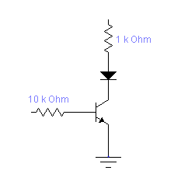




Logic gates and Boolean Algebra
+5V
+5V
Door
Open
Close
+5V
Logic
circuit
LED
Ignition
On
Off
Alarm
+5V
On
Off
Light

Slide 58
Logic gates and Boolean Algebra
Karnaugh Map Method:
It is a graphical tool for simplifying logic equation or to convert a truth table to its corresponding logic circuit.
K-Map standard format:
B
BC
00
01
11
10
A
0
1
A
0
0 | 1
2 | 3
0
0 | 1 | 3 | 2
4 | 5 | 7 | 6
1
1
CD
00
01
11
10
AB
00
0 | 1 | 3 | 2
4 | 5 | 7 | 6
12 | 13 | 15 | 14
8 | 9 | 11 | 10
01
11
10

Slide 59
Logic gates and Boolean Algebra
Design a logic circuit that has three inputs A, B & C and whose output will be high only when input A becomes high while input B C have different value. Draw circuit for simplified expression.
y = A B C + A B C
Y = A (B C + B C)
Y = A (B C)
BC
00
01
11
10
ABC | Y
000 | 0
001 | 0
010 | 0
011 | 0
100 | 0
101 | 1
110 | 1
111 | 0
A
0
1
1
1
+

Slide 60
Logic gates and Boolean Algebra
Looping concept:
The process of combining squares that contains 1’s in the K-map is called looping.
Proper looping becomes very important in K-Map to get simplified expression.
Looping for two:
B
BC
00
01
11
10
0
1
B
0
1
A
A
A
0
0
0
1 1
1
1
1 1
1
1
1
BC
BC
A
00
01
11
10
A
00
01
11
10
0
1
1
0
1 |  |  | 1
1
1

Slide 61
Logic gates and Boolean Algebra
Looping for four:
CD
AB
00
01
11
10
00
 |  |  | 1
 |  |  | 1
01
11
10
1 1
CD
CD
AB
00
01
11
10
AB
00
01
11
10
00
1
1
1
1
00
01
01
1 1 1 1
11
11
10
10

Slide 62
Logic gates and Boolean Algebra
CD
CD
AB
00 1
01
11
10
AB
00
01
11
10
00
 |  |  | 1
1 |  |  | 1
00
01
01
1 1
1 1
11
11
10
10
CD
CD
AB
00
01
11
10
AB
00
01
11
10
00
1 |  |  | 1
1 |  |  | 1
00
 |  | 1 | 1
 |  | 1 | 1
01
01
11
11
10
10

Slide 63
Logic gates and Boolean Algebra
Looping for Eight:
CD
CD
AB
00
01
11
10
AB
00
01
11
10
00
 | 1 | 1
 | 1 | 1
 | 1 | 1
 | 1 | 1
00
1 | 1 | 1 | 1
1 | 1 | 1 | 1
01
01
11
11
10
10
CD
AB
00
01
11
CD
10
AB
00
01
11
10
00
1 |  |  | 1
1 |  |  | 1
1 |  |  | 1
1 |  |  | 1
00
1 | 1 | 1 | 1
1 | 1 | 1 | 1
01
01
11
11
10
10

Slide 64
Logic gates and Boolean Algebra
Simplify the expression mentioned below using K-Map.
f(A,B,C) = ∑ (1,3,5,7).
f (A,B,C,D) = ∑ (0,2,5,8,11,13,15).
f (A,B,C,D) = ∑ (1,3,6,9,12,13,15).
f (A,B,C,D) = ∑ (0,2,8,10,12,14,15).
Using K-Map, Simplify the Boolean expression mentioned below.
Y = A (B C D + C D) + C D + C D.
Y = A B C D + A C D + C D + C D.
Y = D + AC.
CD
AB
00
01
11
10
00
1 |  | 1 | 1
1 |  | 1 | 1
1 |  |  | 1
1 |  |  | 1
01
11
10

Slide 65
Logic gates and Boolean Algebra
Simplify the following Boolean function using different variables K-Map.
A B + A B + B C.
A B C + B C + A C D.
A B C D + A B + B C + C D.
f (A,B,C,D) = ∑ (0,2,8,10,12,13,14,15).
Y = AB + B D
CD
AB
00
01
11
10
00
1 |  |  | 1
1 | 1 | 1 | 1
1 |  |  | 1
01
11
10

Slide 66
Logic gates and Boolean Algebra
Simplify the expression mentioned below using K-Map.
f(A B C D) = ∑ (0,1,2,3,7,8,9,10,11,15).
Y = B + CD
CD
AB
00
01
11
10
00
1 | 1 | 1 | 1
 |  | 1
 |  | 1
1 | 1 | 1 | 1
01
11
10

Slide 67
Logic gates and Boolean Algebra
Find SOP and POS for four variable function mentioned below.
f(A,B,C,D) = ∑ (1,3,5,10,11,12,13,14,15).
f(A,B,C,D) = ∏ (0,2,4,6,7,8,9).
f(A,B,C,D) = AB+AC+A B D+B C D. f(A,B,C,D) = (A+D)(A+B+C)(A+B+C).
CD
CD
AB
00
01
11
10
AB
00
01
11
10
00
 | 1 | 1
 | 1
1 | 1 | 1 | 1
 |  | 1 | 1
00
0 |  |  | 0
0 |  | 0 | 0
0 | 0
01
01
11
11
10
10

Slide 68
Logic gates and Boolean Algebra
Don’t care conditions:
For certain input conditions, when there is no specified output levels, under such circumstances “Don’t care’’ is used.
Normally, the symbol “X” is used for “Don’t care”.
Design a code converter circuit which convert “BCD to Excess-3 code”. Use “don’t care” condition for unpredictable output.
Since each code uses four bits to represent a decimal digit, there must be four input variables and four output variables.
Let four input binary variables as A,B,C & D and four output variables as S,T,U & V.

Slide 69
Logic gates and Boolean Algebra
BCD Excess- 3
a K-Map for S:
S = A + BD + BC
A | B | C | D | S | T | U | V
0 | 0 | 0 | 0 | 0 | 0 | 1 | 1
0 | 0 | 0 | 1 | 0 | 1 | 0 | 0
0 | 0 | 1 | 0 | 0 | 1 | 0 | 1
0 | 0 | 1 | 1 | 0 | 1 | 1 | 0
0 | 1 | 0 | 0 | 0 | 1 | 1 | 1
0 | 1 | 0 | 1 | 1 | 0 | 0 | 0
0 | 1 | 1 | 0 | 1 | 0 | 0 | 1
0 | 1 | 1 | 1 | 1 | 0 | 1 | 0
1 | 0 | 0 | 0 | 1 | 0 | 1 | 1
1 | 0 | 0 | 1 | 1 | 1 | 0 | 0
 |  |  |  | x | x | x | x
 |  |  |  | x | x | X | x
 |  |  |  | x | x | x | x
 |  |  |  | x | x | x | x
 |  |  |  | x | x | x | x
 |  |  |  | x | x | x | x
CD
00
01
11
10
AB
00
 | 1 | 1 | 1
x | x | x | x
1 | 1 | x | x
01
11
10

Slide 70
Logic gates and Boolean Algebra
Five variable K-Map:
It consists two copies of four variable map, one of which reflected or flipped horizontally.
CDE
AB
000
001
011
010
110
111
101
100
00
0 | 1 | 3 | 2 | 6 | 7 | 5 | 4
8 | 9 | 11 | 10 | 14 | 15 | 13 | 12
24 | 25 | 27 | 26 | 30 | 31 | 29 | 28
16 | 17 | 19 | 18 | 22 | 23 | 21 | 20
01
11
10

Slide 71
Logic gates and Boolean Algebra
Simplify the given function of five variables using K-Map.
f(A,B,C,D,E) = ∑ (0,4,6,7,8, 11,12,16,20,22,23,24,26,27,28,30,31).
f(A,B,C,D,E) = D E + A B D + B C D + B C D E .
CDE
AB
000
001
011
010
110
111
101
100
00
1 |  |  |  | 1 | 1 |  | 1
1 |  | 1 |  |  |  |  | 1
1 |  | 1 | 1 | 1 | 1 |  | 1
1 |  |  |  | 1 | 1 |  | 1
01
11
10

Slide 72
Logic gates and Boolean Algebra
Venn diagram:
Helpful illustration used to visualize the relationship among variables of Boolean expression is the Venn diagram.
For A = 1 indicates that one is inside the circle and for A = 0, indicates one outside the circle.
Venn diagram for two variables. A = (AB+A)
A
B
A
B
A B
AB
A B
A B

Slide 73
Combinational Logic Circuit
Combinational circuit output at any instant depend on present combination of inputs without regard to previous inputs.
Combinational circuit performs a specific information processing operation fully specified logically by a set of Boolean functions.
n-input
variables
Combinational
Logic Circuit
m-output
variables
Figure2.1 Block diagram for
Combinational circuit.

Slide 74
Combinational Logic Circuit
Adders
a) Half adder
Combinational circuit that performs addition of two bits is called half adder.
The input variables designate as augends and addend bits.
The output variables produce the sum and carry.
K-Map for Sum. K-Map for sum Carry.
S = A B + A B C = AB
B
B
A
0
1
A
0
1
AB | C | S
00 | 0 | 0
01 | 0 | 1
10 | 0 | 1
11 | 1 | 0
0
0
1
1
1
1
1

Slide 75


Combinational Logic Circuit
A
S = A B + A B
B
C = AB
Full Adder
A combinational circuit that
perform binary addition for
three bits.
ABC | C | S
000 | 0 | 0
001 | 0 | 1
010 | 0 | 1
011 | 1 | 0
100 | 0 | 1
101 | 1 | 0
110 | 1 | 0
111 | 1 | 1

Slide 76
Combinational Logic Circuit
K-Map for Sum:
S = A B C + A B C + A B C + A B C.
K-Map for Carry:
C = A C + A B + B C.
BC
A
00
01
11
10
0
1
1
1
1
1
BC
A
00
01
11
10
0
 |  | 1
 | 1 | 1 | 1
1

Slide 77
Combinational Logic Circuit
A
B
Sum
Carry
C

Slide 78

Combinational Logic Circuit
Subtractors
Half subtractor:
Perform binary subtraction for two bits and produces their differences.
AB | BR | D
00 | 0 | 0
01 | 1 | 1
10 | 0 | 1
11 | 0 | 0
A
D = A B + A B
B
BR = A B

Slide 79
Combinational Logic Circuit
Full subtractor:
D = A B C + A B C + A B C + A B C.
BR = A B + A C + B C.
BC
A
00
01
11
10
ABC | BR | D
000 | 0 | 0
001 | 1 | 1
010 | 1 | 1
011 | 1 | 0
100 | 0 | 1
101 | 0 | 0
110 | 0 | 0
111 | 1 | 1
0
1
1
1
1
1
BC
A
00
01
11
10
0
 | 1 | 1 | 1
 |  | 1
1

Slide 80
Combinational Logic Circuit
4-bit Binary | Gray
A B C D | S T U V
0 0 0 0 | 0 0 0 0
0 0 0 1 | 0 0 0 1
0 0 1 0 | 0 0 1 1
0 0 1 1 | 0 0 1 0
0 1 0 0 | 0 1 1 0
0 1 0 1 | 0 1 1 1
0 1 1 0 | 0 1 0 1
0 1 1 1 | 0 1 0 0
1 0 0 0 | 1 1 0 0
1 0 0 1 | 1 1 0 1
1 0 1 0 | 1 1 1 1
1 0 1 1 | 1 1 1 0
1 1 0 0 | 1 0 1 0
1 1 0 1 | 1 0 1 1
1 1 1 0 | 1 0 0 1
1 1 1 1 | 1 0 0 0
Code conversion:
Code convertor circuit makes
two systems compatible with
each other even though each
uses a different binary.
Sometimes, output of one
system use as input to other
system.
Each system uses different code
for same information.

Slide 81
Combinational Logic Circuit
CD
CD
AB
00
01
11
10
AB
00
01
11
10
00
1 | 1 | 1 | 1
1 | 1 | 1 | 1
00
1 | 1 | 1 | 1
1 | 1 | 1 | 1
01
01
11
11
10
10
S = A
T = A B + A B
CD
CD
AB
00
01
11
10
AB
00
01
11
10
00
 |  | 1 | 1
1 | 1
1 | 1
 |  | 1 | 1
00
 | 1 |  | 1
 | 1 |  | 1
 | 1 |  | 1
 | 1 |  | 1
01
01
11
11
10
10
U = B C + B C
V = C D + C D

Slide 82
Combinational Logic Circuit
S = A
A
T = A B + A B
B
U = B C + B C
C
V = C D + C D
D

Slide 83
Combinational Logic Circuit
BCD to Excess -3 Code:
Refer previous slide for don’t care condition, already solved.
Parity generation and checking:
The circuit that generates parity bit at transmitter is called “parity generator” and circuit that checks parity bit at receiver is called a “parity checker”.
Parity bit is an extra bit included with message to make total number of 1’s either odd or even.
An error is detected if checked parity does not correspond with the one transmitted.

Slide 84
Combinational Logic Circuit
3-bit message parity bit:
P = A B C + A B C + A B C + A B C
P = A B C + A B C + A B C + A B C
P = C(A B + A B) + C( A B + A B)
P = C(A B + A B) + C( A B + A B)
P = (A B) C
BC
A
00
01
11
10
ABC | P(even)
000 | 0
001 | 1
010 | 1
011 | 0
100 | 1
101 | 0
110 | 0
111 | 1
0
1
1
1
1
1
+
+

Slide 85
Combinational Logic Circuit
ABCP | Ck(even)
0000 | 0
0001 | 1
0010 | 1
0011 | 0
0100 | 1
0101 | 0
0110 | 0
0111 | 1
1000 | 1
1001 | 0
1010 | 0
1011 | 1
1100 | 0
1101 | 1
1110 | 1
1111 | 0
Parity checker:
Four bit received parity error check:
Ck = A B C P + A B C P + A B C P +
A B C P + A B C P + A B C P +
A B C P + A B C P.
Ck = A B C P.
CP
AB
00
01
11
10
00
1
1
01
1
1
11
1
1
10
1
1
+
+
+

Slide 86
Combinational Logic Circuit
A
B
P
C
A
B
Ck
C
P

Slide 87
Combinational Logic Circuit
Multilevel NAND Gates:
For given Boolean function, draw logic diagram with AND, OR and NOT gates.
Convert all AND gates to NAND gates with AND invert graphic symbol.
Convert all OR gates to NAND gates with invert OR graphic symbols.
Check all small circles in the diagram.
eg. Y = (A + B C)(D + E F)

Slide 88
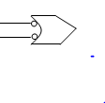
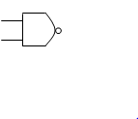
Combinational Logic Circuit
A
B
C
Y = (A + B C) ( D + E F)
D
E
F
A
B
C
D
E
F

Slide 89
Combinational Logic Circuit
Multilevel NAND gates:
A
B
C
Y
D
E
F

Slide 90
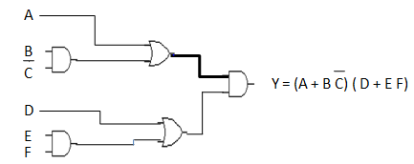
Combinational Logic Circuit
Multilevel NOR gates:
Draw the AND-OR logic diagram from the given algebraic expression.
Convert all OR gates to NOR gates with OR-invert graphic symbols.
Convert all AND gates to NOR gates with invert AND graphic symbols.
Any small circle that is not compensated by another small circle along the same line needs an inverter.
eg. Y = (A+BC)(D+EF).

Slide 91


Combinational Logic Circuit
Multilevel NOR gate:
A
B
C
Y
D
E
F
A
B
C
D
Y
E
F

Slide 92
MSI Combinational Logic Circuit
MSI Components perform specific digital functions commonly needed in the design of digital systems.
Decoder
A combinational circuit that converts binary information from n-input lines to a maximum of 2^{n} unique output lines.
Inputs Outputs
A B | O0 O1 O2 O3
0 0 | 1 0 0 0
0 1 | 0 1 0 0
1 0 | 0 0 1 0
1 | 0 0 0 1

Slide 93
MSI Combinational Logic Circuit
Decoder:
A
B
O0
O1
O2
O3

Slide 94
MSI Combinational Logic Circuit
Design a combinational Full adder circuit with a decoder and two OR gates.
Encoder:
It performs the inverse operation of a decoder.
It convert binary information from 2^{n} (or fewer)input lines to n-output lines.
Inputs | Outputs
I0 I1 I2 I3 | O1 O2
1 0 0 0 | 0 0
0 1 0 0 | 0 1
0 0 1 0 | 0
0 0 0 1 | 1 1

Slide 95

MSI Combinational Logic Circuit
O1 = I2 + I3
O2 = I1 + I3
I_{O}
I₁
I₂
I₃
O₁
O₂

Slide 96
MSI Combinational Logic Circuit
Multiplexer:
A combinational circuit that selects binary information from one of many inputs lines and directs it to a single output line.
The selection of particular input line is controlled by a set of selection lines.
It transmits a large number of information over a smaller number of channels or lines.
In Multiplexer, For 2^{n} input lines there becomes n-selection lines and single output line.
Inputs | Selection lines | Output
2² | 2 | 1
2³ | 3 | 1
2⁴ | 4 | 1
. | . | .
2^{n} | n | 1

Slide 97
MSI Combinational Logic Circuit
Multiplexer:
S1 | S2 | Y
0 | 0 | I0
0 | 1 | I1
1 | 0 | I2
1 | 1 | I3
S1
S2
_{I0}
_{I1}
Y
_{I2}
_{I3}

Slide 98
MSI Combinational Logic Circuit
De-multiplexer:
A combinational circuit that receives information on a single line and transmits this information on one of 2^{n} possible output lines.
De-multiplexer performs the inverse operation of Multiplexer.
The selection of particular output line is controlled by the bit values of n selection lines.
It transmits single information
over a large number of
channels or lines.
Input | Selection lines | Outputs
1 | 2 | 2²
1 | 3 | 2³
1 | 4 | 2⁴
. | . | .
1 | n | 2^{n}

Slide 99
MSI Combinational Logic Circuit
De-multiplexer:
S1
S2
S1 S2 | Y
0 0 | O0
0 1 | O1
1 0 | O2
1 1 | O3
O₀
O₁
O₂
O₃
I

Slide 100
MSI Combinational Logic Circuit
Binary parallel adder:
It produces the arithmetic sum of two binary numbers in parallel.
A1
B1
A2
B2
A3
B3
A4
B4
FA
FA
FA
FA
C1
C5
S1
S2
S3
S4
Diagram 4-bit parallel adder.

Slide 101
MSI Combinational Logic Circuit
Binary adder – subtractor :
Design an binary adder/subtractor circuit with one selection variable M and two inputs A and B. For M = 0, the circuit need to perform addition i.e. (A+B) and for M = 1, the circuit must perform subtraction i.e. (A - B) by taking 2’s complement of B.
For M = 0, it becomes B 0 = B. The full adder receive the value of B, the input carry is 0, and the circuit performs ( A + B).
For M = 1, it becomes B 1 = B and C1 = 1. The input B are complemented and a 1 is added via the input carry. The circuit performs the operation A + 2’S complement of B i.e. (A – B) operation.
+
+

Slide 102
MSI Combinational Logic Circuit
B1
A1
B2
A2
B3
A3
B4
A4
M
FA
FA
FA
FA
C2
C3
C4
C1
S1
S2
S3
S4
C5

Slide 103
MSI Combinational Logic Circuit
BCD Adder:
It adds two BCD digits in parallel and produces sum digit also in BCD.
To add 0110 to binary sum, one can use a second 4-bit binary adder as shown in diagram.
When output carry becomes equal to zero, nothing is added to the binary sum.
When output carry becomes equal to one, the binary 0110 is added to the binary sum via bottom 4-bit binary adder.
The output carry generated from the bottom binary adder can be ignored, since it supplies information already available at output carry terminal.

Slide 104
MSI Combinational Logic Circuit
BCD Adder:
Addend
Augend
4-bit binary adder
Carry out
Carry in
Z₈
Z₄
Z₂
Z₁
Output
carry
0
4-bit binary adder
0
1
1
0
S₈
S₄
S₂
S₁

Slide 105
Programmable Logic Device
PLD:
It plays very important role in the design for digital system.
Fixed AND array
Fused
Programmable
OR array
I/P
O/P
Fuses
Diag.a PROM
Fused
Programmable
AND array
Fixed OR array
I/P
O/P
Diag.b PAL
Fused
Programmable
AND array
Fused
Programmable
OR array
I/P
O/P
Diag.c PLA

Slide 106
Programmable Logic Device
ROM:
Consider a 16 x 8 ROM, i.e. it has four inputs, eight outputs and ROM contains 16x8 = 128 programmable connections.
2^{K} X n
ROM
K-input
(Address)
n-output
(data)
Block diagram of ROM
Inputs | Outputs
I3 I2 I1 I0 | O7 O6 O5 O4 O3 O2 O1 O0
0 0 0 0 | 1 0 0 0 1 1 1 0
0 0 0 1 | 0 1 1 0 0 1 0 1
. . . .
1 1 1 1 | 1 1 0 0 0 0 1 1

Slide 107

Programmable Logic Device
4 X 16
Decoder
0
I₀
1
I₁
2
I₂
I₃
15
O₇
O₆
O₅
O₄
O₃
O₂
O₁
O_{O}
O7 (I3,I2,I1,I0) = ∑m(0, …………,15)

Slide 108
Programmable Logic Device
PLA:
Similar in concept to PROM, except that PLA does not provide full decoding of variables and does not generate all the min-terms.
The decoder is replaced by an array of AND gates that can be programmed to generate product terms of input variables.
The product terms are then selectively connected to OR gates to provide the sum of products for the required Boolean functions.
Design a combinational circuit using PLD device as PLA (4x8x4), and that is used to implement the full subtractor functions in which difference represented Di and borrow represented as Br.

Slide 109
Programmable Logic Device
Truth table
Inputs | Outputs
I3 I2 I1 I0 A B C | O3 O2 O1 O0 D Br
X 0 0 0 | X X 0 0
X 0 0 1 | X X 1 1
X 0 1 0 | X X 1 1
X 0 1 1 | X X 0 1
X 1 0 0 | X X 1 0
X 1 0 1 | X X 0 0
X 1 1 0 | X X 0 0
X 1 1 1 | X X 1 1

Slide 110
Programmable Logic Device
K-map:
D = A B C + A B C + A B C + ABC.
Br = A B + A C + B C
BC
00
01
11
10
A
0
1
1
1
1
1
BC
A
00
01
11
10
0
 | 1 | 1 | 1
 |  | 1
1

Slide 111


Programmable Logic Device
A
B
C
I3
I2
I1
I0
OR array
A B C
A B C
A B C
A B C
A B
A C
BC
AND array
0
1
O₃
O₂
O₁ (Br)
O₀ (D)
Output array

Slide 112
Programmable Logic Device
PAL:
It consists of programmable array of AND gates that connects to a fixed array of OR gates.
Suitable for sum of products.
Input variables are buffered to prevent loading by large number of AND gates inputs.
Design a combinational circuit using PLD device as PAL to implement the expression mentioned below.
Y = A B + A B + A B .

Slide 113
Programmable Logic Device
A
B
A
Fixed connection
B
A B
A B
Y = A B + A B + A B
A B
Fuse intact

Slide 114

Sequential Logic Circuit
Inputs
Combinational
Circuit
Outputs
Storage
Element
Block diagram of sequential circuit

Slide 115
Sequential Logic Circuit
Latches and Flip-flop:
The major difference between the various types of Latches and flip-flops are the number of inputs they posses and the number in which inputs effect the binary state.
Latches are most often used within flip-flops.
Latches assumed to be transparent .
Flip-flops, assumed to be not transparent.

Slide 116

Sequential Logic Circuit
SR Latches:
S R Q Q | State
1 0 1 0 | Set state
0 0 1 0 | Set state
0 1 0 1 | Reset state
0 0 0 1 | Reset state
1 1 0 0 | Undefined
Reset
(R)
Q
Set
(S)
Q

Slide 117
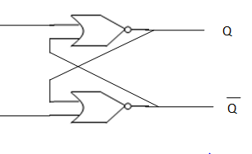
Sequential Logic Circuit
Clocked S R Flip-flop:
Q S R | Q(t+1)
0 0 0 | 0
0 0 1 | 0
0 1 0 | 1
0 1 1 | Indeterminate
1 0 0 | 1
1 0 1 | 0
1 0 | 1
1 1 1 | Indeterminate
R
CLK
S
SR
00
01
11
10
Q
0
 |  | X | 1
1 |  | X | 1
1
Q(t+1) = S + R Q

Slide 118

Sequential Logic Circuit
D Flip-flop:
D
Q
CLK
Q
D
Q D | Q(t+1)
0 0 | 0
0 1 | 1
0 | 0
1 1 | 1
Q
0
1
0
 | 1
 | 1
1
Q(t+1) = D

Slide 119

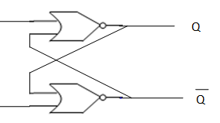
Sequential Logic Circuit
J K Flip-flop:
It is the refinement form of the RS flip-flop wherein in-determinant state of RS type is eliminated.
Q J K | Q(t+1)
0 0 0 | 0
0 0 1 | 0
0 1 0 | 1
0 1 1 | 1
1 0 0 | 1
1 0 1 | 0
1 1 0 | 1
1 1 1 | 0
K
CLK
J

Slide 120
Sequential Logic Circuit
JK
Q
00
01
11
10
0
 |  | 1 | 1
1 |  |  | 1
1
Q(t+1) = Q J + Q K

Slide 121
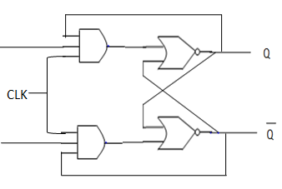
Sequential Logic Circuit
T Flip-flop:
Q T | Q(t+1)
0 0 | 0
0 1 | 1
0 | 1
1 1 | 0
T
Q
T
0
1
0
1
1
1
Q (t+1) = Q T + Q T

Slide 122
Sequential Logic Circuit
Master Slave Flip-flop:
It constructed from two separate flip-flops wherein one circuit serves as a master and other as a slave and overall circuit is referred to as a master slave flip-flop.
S
Master
Y
Slave
Q
R
Y
Q
CLK
Logic diagram for Master Slave Flip-flop.

Slide 123
Sequential Logic Circuit
Timing relationships:
CLK
S
Y
Q

Slide 124
Sequential Logic Circuit
Master Slave Flip-flop:
J
Y
Q
Y
Q
K
CLK
Clocked Master Slave JK Flip-flop

Slide 125
Sequential Logic Circuit
Edge-triggered flip-flop:
Flip-flop that synchronizes state changes during clock pulse transition is termed as Edge triggered flip-flop.
S
Q
CLK
R
Q
D
D-type positive edge triggered flip-flop

Slide 126
Sequential Logic Circuit
Analysis of clocked sequential circuit:
State Diagram:
Design a sequential circuit from given state diagram using D flip-flops.
0/0
00
0/1
1/1
0/0
01
11
1/1
0/1
0/0
10
0/0

Slide 127
Sequential Logic Circuit
Excitation table:
Q(t) | Q(t+1) | S R
0 | 0 | 0 X
0 | 1 | 0
1 | 0 | 0 1
1 | 1 | X 0
Q(t) | Q(t+1) | J K
0 | 0 | 0 X
0 | 1 | X
1 | 0 | X 1
1 | 1 | X 0
Q(t) | Q(t+1) | D
0 | 0 | 0
0 | 1 | 1
1 | 0 | 0
1 | 1 | 1
Q(t) | Q(t+1) | T
0 | 0 | 0
0 | 1 | 1
1 | 0 | 1
1 | 1 | 0

Slide 128
Sequential Logic Circuit
Counter Design:
A sequential circuit that goes through a prescribed sequence of state upon the application of clock pulses is called a counter.
A counter that follows the binary sequence is called binary counter.
An n-bit binary counter consists of n flip-flops and can count from 0 to 2^{n}-1.
Design a counter using T Flip-flop that counts the binary sequence from 000 to 111 and returns to 000 to repeat the sequence.

Slide 129
Sequential Logic Circuit
Counter Design:
000
111
001
010
110
011
101
100

Slide 130
Sequential Logic Circuit
Counter design:
Count sequence(PS) | Next state
A2 A1 A0 | A2 A1 A0
0 0 0 | 0 0 1
0 0 1 | 0 1 0
0 1 0 | 0 1 1
0 1 1 | 1 0 0
1 0 0 | 1 0 1
1 0 1 | 1 1 0
1 1 0 | 1 1 1
1 1 1 | 0 0 0
Flip-flop inputs
TA2 TA1 TA0
0 0 1
0 1 1
0 0 1
1 1 1
0 0 1
0 1 1
0 0 1
1 1 1

Slide 131
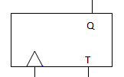
Sequential Logic Circuit
From K-map:
TA2 = A1A0.
TA1 = A0.
TA0 = 1.
A0
A1
A2
Count pulse
1
Logic diagram for 3-bit binary counter

Slide 132
Sequential Logic Circuit
Design a counter using D Flip-flops that counts the binary sequence from 00 to 11 and returns to 00 to repeat the sequence.
Design a counter using D Flip-flops that counts the binary sequence from 111 to 000 and returns to 111 to repeat the sequence.
Design a BCD counter using T Flip-flops that counts the binary sequence from 0000 to 1001 and returns to 0000 to repeat the sequence.

Slide 133
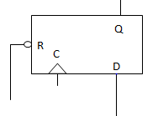
Sequential Logic Circuit
Registers:
A register consists of a group of binary storage cells suitable for holding binary information.
An n-bit register include n flip-flops, and capable to store n-bit information.
A group of flip-flops constitute a register.
Q1
Q2
Q3
Q4
CLK
Clear
I1
I2
I3
I4
Diag. 4-bit register

Slide 134
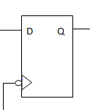
Sequential Logic Circuit
Shift register:
A register capable of shifting its binary information either to the right or to the left is called a shift register.
It consists chain of flip-flop connected in cascade with output of one flip-flop connected to input of next flip-flop.
All flip-flops receive a common clock pulse which causes a shift from one stage to the next.
SI
Serial
input
SO
Serial
output
Diag. Shift register

Slide 135
Sequential Logic Circuit
Serial Transfer:
A digital system is said to operate in serial mode when information is transferred and manipulated one bit at a time.
The content of one register is transferred to another by shifting the bits from one register to the other.
Information is transferred one bit at a time by shifting the bit out of the source register into destination register.
SI
Shift register A
SO
SI
Shift register B
SO
Clock
Clk
Shift
Control

Slide 136
Sequential Logic Circuit
Timing pulse | Shift register A | Shift register B | Serial output of B
Initial value | 1 0 0 1 | 0 1 0 1 | 1
After T1 | 1 1 0 0 | 1 0 1 0 | 0
After T2 | 0 1 1 0 | 0 1 0 1 | 1
After T3 | 0 0 1 1 | 0 0 1 0 | 0
After T4 | 1 0 0 1 | 1 0 0 1 | 1

Slide 137
Sequential Logic Circuit
Bidirectional shift register:
A register capable of shifting binary data in both directions is termed as a bidirectional shift register.
Mode Control S2 S3 | Register operation
0 0 | No Change
0 1 | Shift down
0 | Shift up
1 1 | Parallel load

Slide 138
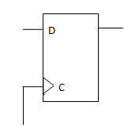
Sequential Logic Circuit
Q i-1
S1
S2
S1
MUX
0
1
2
3
S0
Q i
Di
Q i+1
Clk

Slide 139
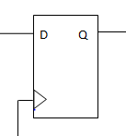
Sequential Logic Circuit
Types of shift register:
1. Serial in serial out shift register.
2. Serial in parallel out shift register.
3. Parallel in serial out shift register.
4. Parallel in parallel out shift register.
Serial in parallel out shift register:
QA
QB
QC
QD
Data
input
Clk

Slide 140
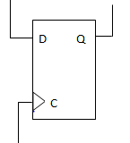
Sequential Logic Circuit
Parallel in serial out shift register:
Shift
Load
A
B
C
D
QD
QA
QB
QC
Serial
Data
out
Clk

Slide 141
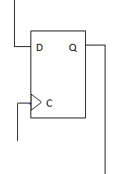
Sequential Logic Circuit
Parallel in parallel out shift register:
Parallel data inputs
A
B
C
D
Clk
QA
QB
QC
QD
Parallel data outputs

Slide 142
Processor Logic Design
Processor unit:
It implements the operation in the system.
It comprised of a number of registers and digital functions that implement arithmetic, logic, shift and transfer micro-operations.
Processor unit on combining with a control unit used to supervise the sequence of micro-operation that is also termed as CPU.
Accumulator Register:
A processor unit that separate one register from all others is termed as an accumulator register, abbreviated as AC or A register.

Slide 143
Processor Logic Design
Accumulator Register:
Input data
Processor registers
Or
Memory unit
Processor registers
Or
Memory unit
Select
B source
A
B
ALU
Accumulator
Register(A)
Diag. processor unit with an accumulator register
output data

Slide 144
Processor Logic Design
T1: A 0 Clear A
T2: A A+R1 Transfer R1 to A
T3: A A+R2 Add R2 to A.

Slide 145
Processor Logic Design
Arithmetic Logic Unit(ALU):
S2 distinguishes between arithmetic logic operations.
S1, So specify particular arithmetic or logic operation.
A
B
A4 A3 A2 A1 B4 B3 B2 B1
ALU
O4 O3 O2 O1
S2(Mode select)
S1
s0
Cout
(Output carry)
(Function select)
Cin(input carry)
O

Slide 146
Processor Logic Design
Arithmetic Circuit Design:
A
B
A
B
Parallel adder
Cin = 0
Cout
Parallel adder
Cin = 1
Cout
0 = A+B
(a) Addition
0 = A+B+1
(b) Addition with carry
A
B
A
B
Parallel adder
Cin = 0
Parallel adder
Cin = 1
Cout
Cout
0 = A+ B
(c) A plus 1’s complement
0 = A+ B +1
(c) Subtraction

Slide 147
Processor Logic Design
Arithmetic circuit design:
A
0
A
0
Cout
Parallel adder
Cin = 0
Cout
Parallel adder
Cin = 1
O = A
(e) Transfer A
O = A +1
(f) Increment A
A
All 1’s
A
All 1’s
Cout
Parallel adder
Cin = 0
Cout
Parallel adder
Cin = 1
O = A -1
(g) Decrement A
O = A
(h) Transfer A

Slide 148
Processor Logic Design
Arithmetic circuit design:
Cin
S1
S0
A1
X1
FA
Y1
B1
O1
A2
X2
FA
Y2
B2
O2

Slide 149
Processor Logic Design
Arithmetic circuit design:
Design an adder/subtractor circuit with one selection variable S and two inputs A and B. For S = 0, the circuit need to perform addition i.e. (A+B) AND FOR S = 1, the circuit must perform subtraction (A –B) by taking 2’s complement of B.
S1 S0 | Yi
0 0 | 0
0 1 | Bi
1 0 | Bi
1 1 | 1
Bi
S0
Yi
S1

Slide 150
Processor Logic Design
Design:
S
C1
A1
X1
FA
Y1
O1
B1
A2
X2
FA
Y2
O2
B2

Slide 151
Processor Logic Design
Logic Circuit Design:
Design a sequential logic circuit that could perform eight different logical gate operation. Use the concept of function table, multiplexer, different gates to obtained the desired result.
Ai
0
1
2
3
MUX
4
5
6
7
Bi
Oi
S2 S1 S0

Slide 152
Processor Logic Design
Logic Design:
S2 S1 S0 | Output | Operation
0 0 0 | Oi = Ai | Buffer
0 0 1 | Oi = Ai | NOT
0 1 0 | Oi = Ai Bi | AND
0 1 1 | Oi = Ai Bi | NAND
1 0 0 | Oi = Ai + Bi | OR
1 0 1 | Oi = Ai + Bi | NOR
1 1 0 | Oi = Ai Bi | EX-OR
1 1 1 | Oi = Ai Bi | EX-NOR
+
.

Slide 153

Counter
Classification of counter:
Synchronous | Asynchronous (Ripple)
The common clock pulse triggers all the flip- flop simultaneously. Comparatively fast, as propagation delay involved is less. Event occurs at same time. Flip-flop within a counter made to change state at exactly same time. | The first flip-flop is clocked by external clock pulse and then each successive flip-flop is clocked by output of previous flip-flop. Comparatively slow, as propagation delay involved is large. Event do not occurs at same time. Flip-flop within a counter not made to change state at exactly same time.

Slide 154
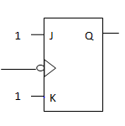
Counter
Ripple Counter:
a) Binary Ripple Counter:
A1
A2
A3
A4
To next stage
Clk
A 4-bit binary ripple counter

Slide 155
Counter
Count sequence | Condition for complementing flip-flop
A4 A3 A2 A1 0 0 0 0 0 0 0 1 0 0 1 0 0 0 1 1 0 1 0 0 0 1 0 1 0 1 1 0 0 1 1 1 1 0 0 0 | Complement A1. Complement A1, A1 will go from 1 to 0 and complement A2. Complement A1. Complement A1, A1 will go from 1 to 0 and complement A2. A2 will go from 1 to 0 and complement A3. Complement A1. Complement A1, A1 will go from 1 to 0 and complement A2. Complement A1. Complement A1. , A1 will go from 1 to 0 and complement A2. A2 will go from 1 to 0 and complement A3. A3 will go from 1 to 0 and complement A4. And so on.

Slide 156
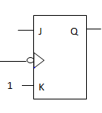
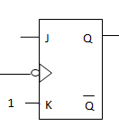
Counter
BCD Ripple Counter:
Q1
Q2
Q4
Q8
Clk
Diag. BCD Ripple Counter

Slide 157
Counter
Condition for each flip-flop state transition are as accordingly:
On negative edge of every count pulse,Q1 is complemented.
When Q8 = 0 and Q1 goes from 1 to 0 then Q2 is complemented. Similarly when Q8 = 1 and Q1 goes from 1 to 0 then Q2 becomes cleared.
When Q2 goes from 1 to 0 then Q4 is complemented.
When Q4Q2 = 11 and Q1 goes from 1 to 0 then Q8 is complemented. Similarly, when if either Q4 or Q2 is 0 and Q1 goes from 1 to 0 then Q8 becomes cleared.

Slide 158
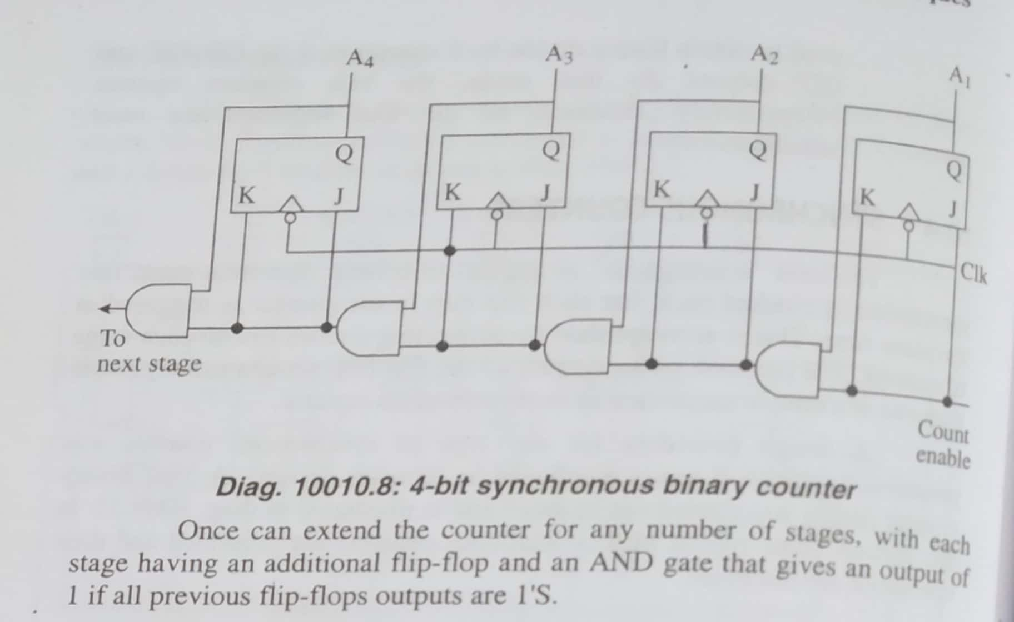
Counter
A 4-bit synchronous counter:

Slide 159
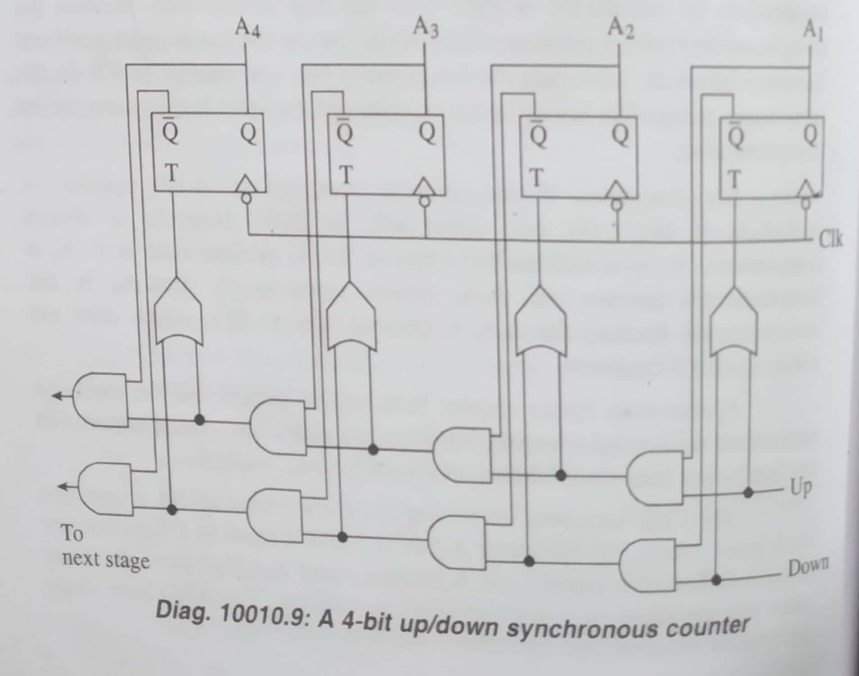
Counter

Slide 160
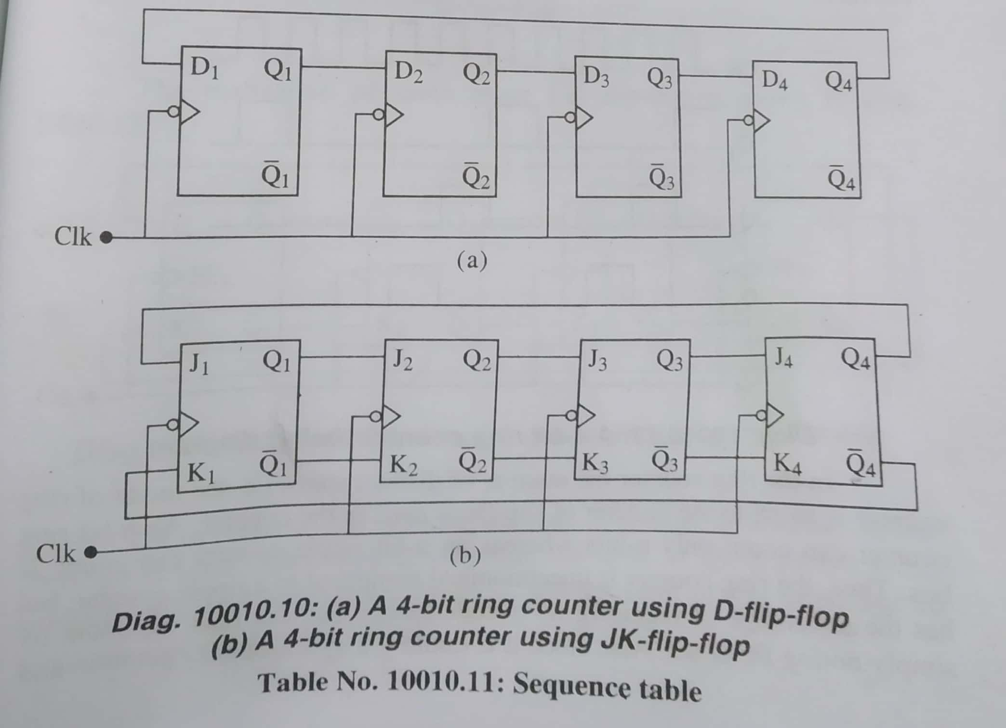
Counter

Slide 161
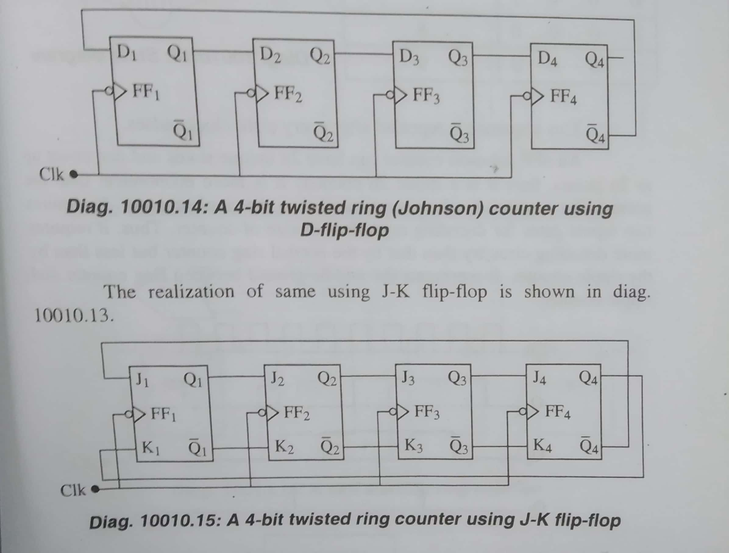
Counter

Slide 162
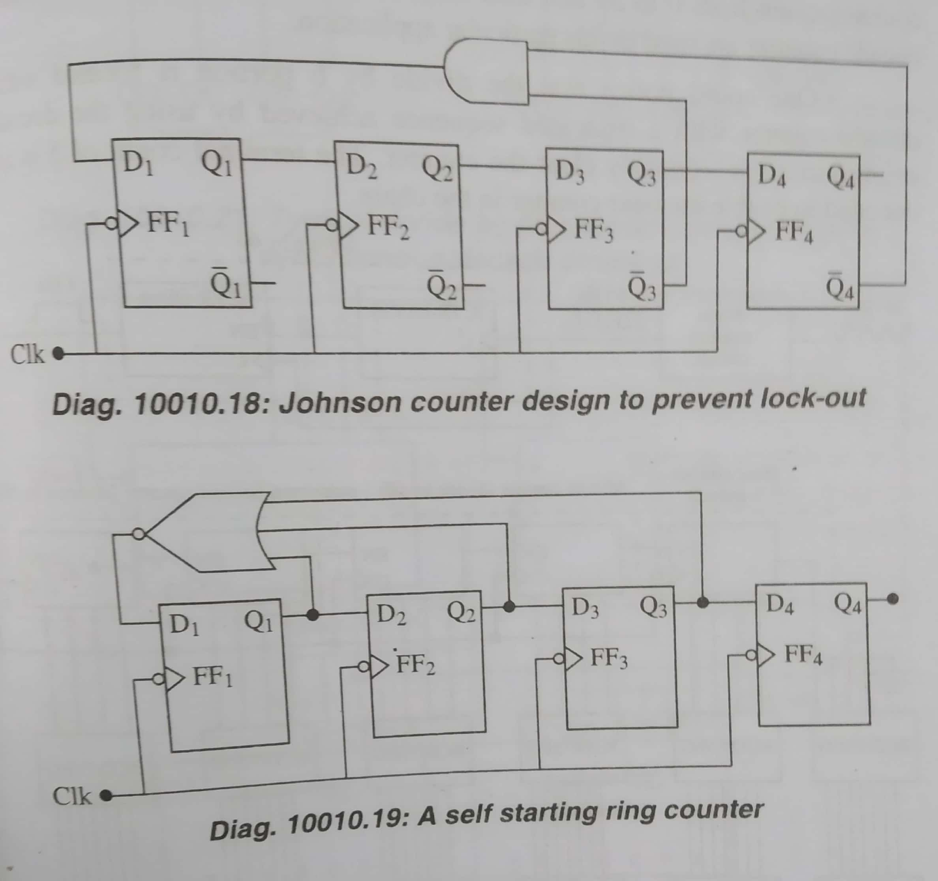
Counter

Slide 163
Counter Application
Counter Application:
Digital clock
Auto parking control
Parallel to serial data conversion
Frequency counter

